Slide 1





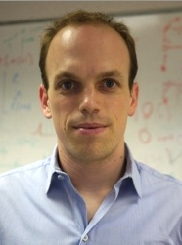
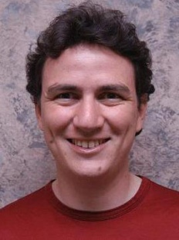
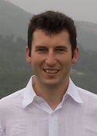

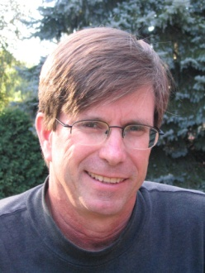
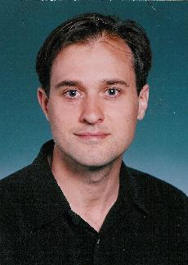
Big Learning with Graphs
Joseph Gonzalez
jegonzal@cs.cmu.edu
Yucheng
Low
Aapo
Kyrola
Haijie
Gu
Danny
Bickson
Arthur
Gretton
Carlos
Guestrin
Alex
Smola
Joe
Hellerstein
David
O’Hallaron
Guy
Blelloch

Slide 2
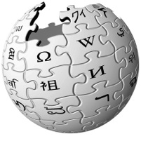



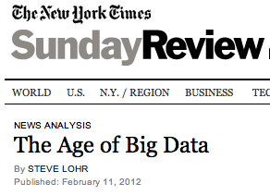
The Age of Big Data
28 Million
Wikipedia Pages
6 Billion
Flickr Photos
900 Million
Facebook Users
72 Hours a Minute
YouTube
“…growing at 50 percent a year…”
“… data a new class of economic asset, like currency or gold.”
Notes:
- everywhere
- useless -> actionable.
- identify trends, create models, discover patterns. → Machine Learning. Big Learning.

Slide 3
Big Data
Big Graphs
Notes:
BigGraph

Slide 4

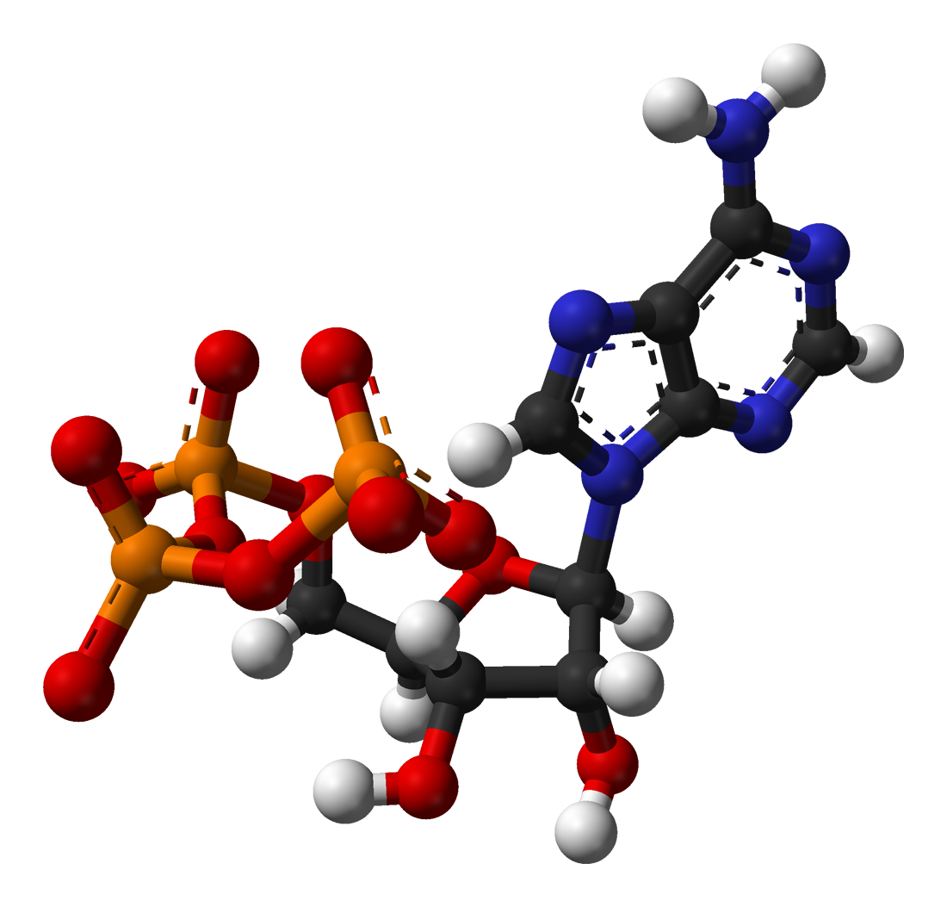





Social Media
Science
Advertising
Web
Graphs encode relationships between:
Big: billions of vertices and edges and rich metadata
People
Products
Ideas
Facts
Interests
Notes:
https://www.facebook.com/facebook
http://www.scientificamerican.com/blog/post.cfm?id=viruses-theyre-alive-and-they-can-i-2008-08-08
Put a number about scale of these graphs

Slide 5
Big graphs present exciting new opportunities ...

Slide 6

Cameras
Cooking
Shopper 1
Shopper 2
Notes:
Here we have two shoppers. We would like to recommend things for them to buy based on their interests. However we may not have enough information to make informed recommendations by examining their individual histories in isolation.
We can use the rich probabilistic structure to improve the recommendations for individual people.

Slide 7
Big-Graphs are Essential to Data-Mining and Machine Learning
Identify influential people and information
Find communities
Target ads and products
Model complex data dependencies
Notes:
PageRank
Viral Propagation & Cascade Analysis
Recommender Systems / Collaborative Filtering
Community Detection
Correlated User Modeling

Slide 8
Big Learning with Graphs
Understanding and using large-scale structured data.

Slide 9
Examples

Slide 10
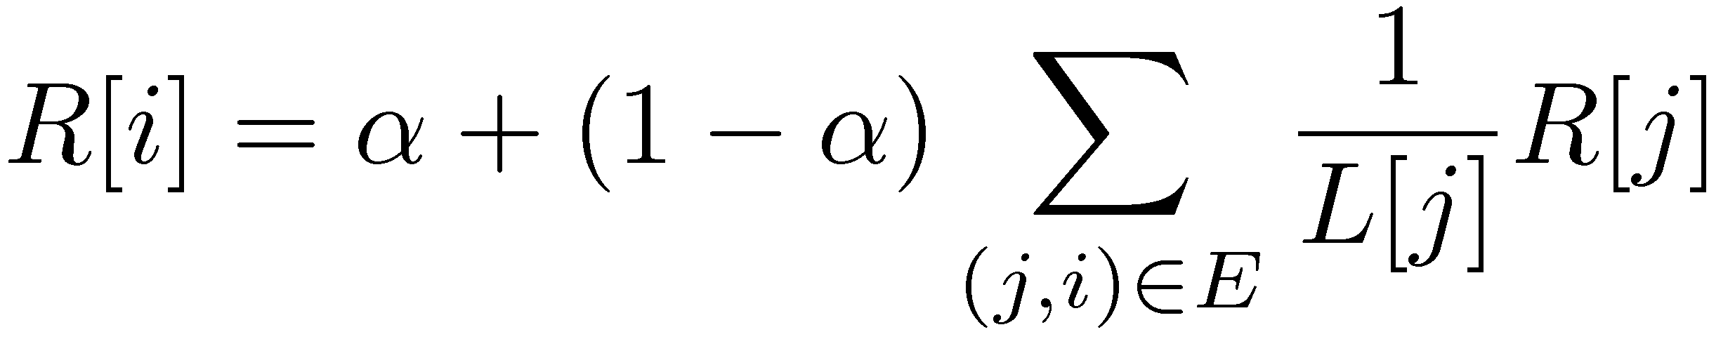
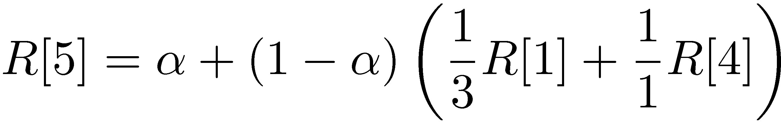
PageRank (Centrality Measures)
Iterate:
Where:
α is the random reset probability
L[j] is the number of links on page j
1
2
3
4
5
6
http://ilpubs.stanford.edu:8090/422/1/1999-66.pdf

Slide 11




Label Propagation (Structured Prediction)
Social Arithmetic:
Recurrence Algorithm:
iterate until convergence
Parallelism:
Compute all Likes[i] in parallel
Sue Ann
50% What I list on my profile
40% Sue Ann Likes
10% Carlos Like
80% Cameras
20% Biking
+
40%
I Like:
60% Cameras, 40% Biking
Profile
50%
50% Cameras
50% Biking
Me
Carlos
10%
30% Cameras
70% Biking
http://www.cs.cmu.edu/~zhuxj/pub/CMU-CALD-02-107.pdf

Slide 12






Collaborative Filtering: Independent Case
Lord of the Rings
Star Wars IV
Star Wars I
recommend
Harry Potter
Pirates of the Caribbean

Slide 13







Collaborative Filtering: Exploiting Dependencies
Women on the Verge of a Nervous Breakdown
The Celebration
City of God
What do I
recommend???
recommend
Wild Strawberries
La Dolce Vita

Slide 14
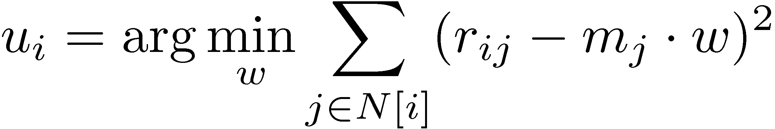
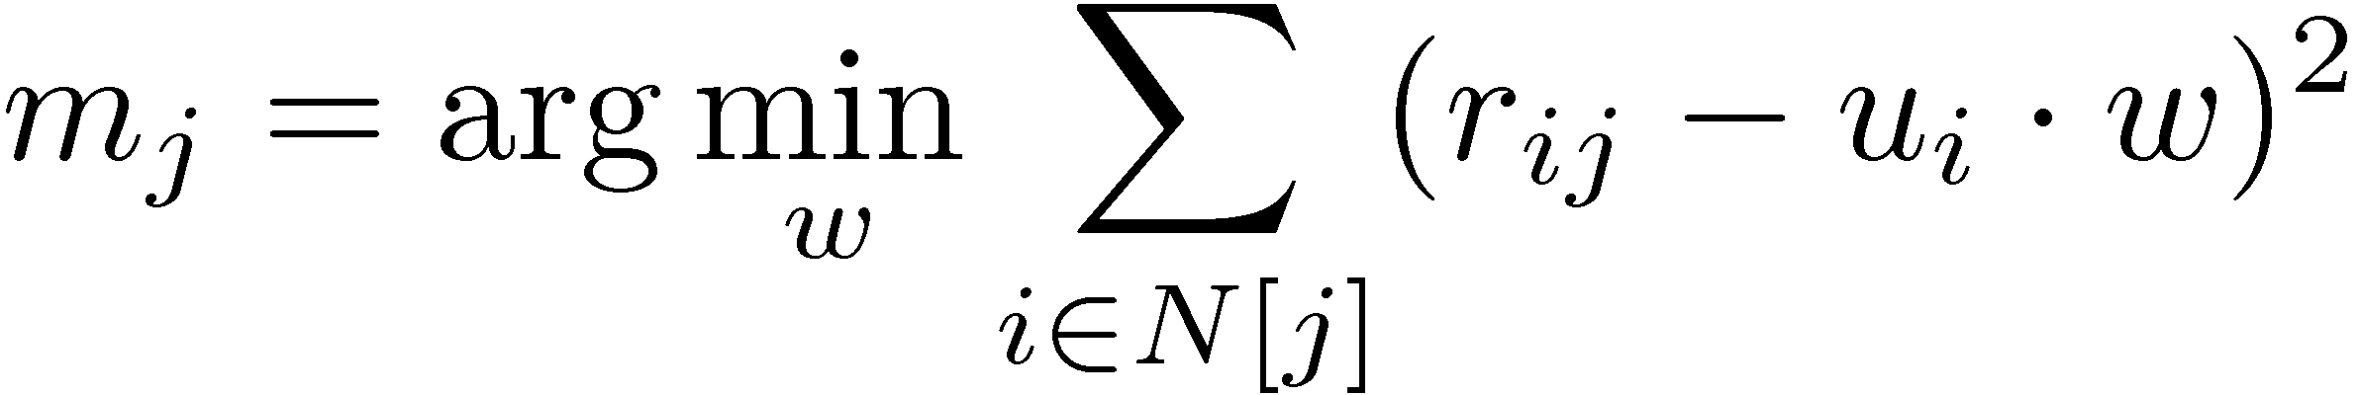
Matrix Factorization Alternating Least Squares (ALS)
m₁
r₁₁
Movies
u₁
Netflix
≈
x
Users
Users
m_{j}
r₁₂
m₂
u_{i}
User Factors (U)
Movie Factors (M)
r₂₃
u₂
Movies
r₂₄
m₃
Iterate:
http://dl.acm.org/citation.cfm?id=1424269

Slide 15
Many More Algorithms
Collaborative Filtering
Alternating Least Squares
Stochastic Gradient Descent
Tensor Factorization
SVD
Structured Prediction
Loopy Belief Propagation
Max-Product Linear Programs
Gibbs Sampling
Semi-supervised ML
Graph SSL
CoEM
Graph Analytics
PageRank
Single Source Shortest Path
Triangle-Counting
Graph Coloring
K-core Decomposition
Personalized PageRank
Classification
Neural Networks
Lasso
…

Slide 16



Graph Parallel Algorithms
Dependency
Graph
Local Updates
Iterative
Computation
My Interests
Friends Interests

Slide 17
What is the right tool for Graph-Parallel ML
Data-Parallel Graph-Parallel
Map Reduce
Map Reduce?
?
Feature
Extraction
Cross
Validation
Collaborative Filtering
Graph Analytics
Structured Prediction
Clustering
Computing Sufficient
Statistics

Slide 18
Why not use Map-Reduce for Graph Parallel algorithms?

Slide 19
Data Dependencies are Difficult
Difficult to express dependent data in Map Reduce
Substantial data transformations
User managed graph structure
Costly data replication
Independent Data Records

Slide 20
Iterative Computation is Difficult
System is not optimized for iteration:
Iterations
Data
Data
Data
Data
CPU 1
CPU 1
CPU 1
Data
Data
Data
Data
Data
Data
Data
Data
CPU 2
CPU 2
CPU 2
Startup Penalty
Disk Penalty
Startup Penalty
Disk Penalty
Startup Penalty
Data
Data
Disk Penalty
Data
Data
Data
Data
Data
Data
CPU 3
CPU 3
CPU 3
Data
Data
Data
Data
Data
Data
Data
Data

Slide 21
Map-Reduce for Data-Parallel ML
Excellent for large data-parallel tasks!
Data-Parallel Graph-Parallel
Map Reduce
MPI/Pthreads
Map Reduce?
Feature
Extraction
Cross
Validation
Collaborative Filtering
Graph Analytics
Structured Prediction
Clustering
Computing Sufficient
Statistics

Slide 22
Threads, Locks, & Messages
We could use ….
“low level parallel primitives”

Slide 23
Threads, Locks, and Messages
ML experts repeatedly solve the same parallel design challenges:
Implement and debug complex parallel system
Tune for a specific parallel platform
Six months later the conference paper contains:
“We implemented ______ in parallel.”
The resulting code:
is difficult to maintain
is difficult to extend
couples learning model to parallel implementation
Graduate students

Slide 24
Addressing Graph-Parallel ML
We need alternatives to Map-Reduce
Data-Parallel Graph-Parallel
Map Reduce
Pregel
MPI/Pthreads
Feature
Extraction
Cross
Validation
Collaborative Filtering
Graph Analytics
Structured Prediction
Clustering
Computing Sufficient
Statistics

Slide 25
Pregel Abstraction
User-defined Vertex-Program on each vertex
Vertex-programs interact along edges in the Graph
Programs interact through Messages
Parallelism: Multiple vertex programs run simultaneously

Slide 26
The Pregel Abstraction
Vertex-Programs communicate through messages
void Pregel_PageRank(i, msgs) :
// Receive all the messages
float total = sum(m in msgs)
// Update the rank of this vertex
R[i] = β + (1-β)*total
// Send Messages to neighbors
foreach(j in out_neighbors[i]) :
SendMsg(nbr, R[i] * w_{ij})
i
Notes:
Define synchronous

Slide 27
Pregel is Bulk Synchronous Parallel
Compute
Communicate
Barrier
http://dl.acm.org/citation.cfm?id=1807184

Slide 28
Open Source Implementations
Giraph: http://incubator.apache.org/giraph/
Golden Orb: http://goldenorbos.org/
Stanford GPS: http://infolab.stanford.edu/gps/
An asynchronous variant:
GraphLab: http://graphlab.org/

Slide 29
Tradeoffs of the BSP Model
Pros:
Graph Parallel
Relatively easy to implement and reason about
Deterministic execution
Cons:
User must architect the movement of information
Send the correct information in messages
Bulk synchronous abstraction inefficient

Slide 30
Curse of the Slow Job
Iterations
Data
Data
Data
Data
CPU 1
CPU 1
CPU 1
Data
Data
Data
Data
Data
Data
Data
Data
CPU 2
CPU 2
CPU 2
Data
Data
Data
Data
Data
Data
Data
Data
CPU 3
CPU 3
CPU 3
Data
Data
Data
Data
Data
Data
Data
Data
Barrier
Barrier
Barrier
http://www.www2011india.com/proceeding/proceedings/p607.pdf

Slide 31
Curse of the Slow Job
Assuming runtime is drawn from an exponential distribution with mean 1.
http://www.www2011india.com/proceeding/proceedings/p607.pdf

Slide 32
Bulk synchronous parallel model provably inefficient for some graph-parallel tasks

Slide 33
Example: Loopy Belief Propagation (Loopy BP)
Iteratively estimate the “beliefs” about vertices
Read in messages
Updates marginal estimate (belief)
Send updated out messages
Repeat for all variables until convergence
http://www.merl.com/papers/docs/TR2001-22.pdf

Slide 34

Bulk Synchronous Loopy BP
Often considered embarrassingly parallel
Associate processor with each vertex
Receive all messages
Update all beliefs
Send all messages
Proposed by:
Brunton et al. CRV’06
Mendiburu et al. GECC’07
Kang,et al. LDMTA’10
…

Slide 35
Sequential Computational Structure

Slide 36
Hidden Sequential Structure

Slide 37
Hidden Sequential Structure
Evidence
Evidence
Running Time:
Time for a single
parallel iteration
Number of Iterations

Slide 38
Optimal Sequential Algorithm
Running
Time
Bulk Synchronous
2n²/p
Gap
p ≤ 2n
Forward-Backward
2n
p = 1
Optimal Parallel
n
p = 2

Slide 39
The Splash Operation
Generalize the optimal chain algorithm: to arbitrary cyclic graphs:
~
Grow a BFS Spanning tree with fixed size
Forward Pass computing all messages at each vertex
Backward Pass computing all messages at each vertex
http://www.select.cs.cmu.edu/publications/paperdir/aistats2009-gonzalez-low-guestrin.pdf

Slide 40
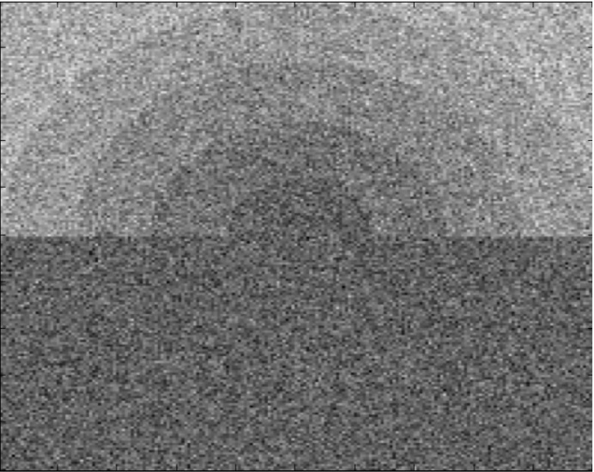
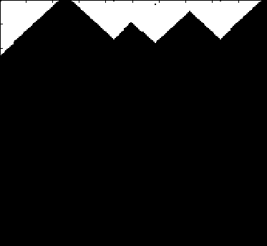
Prioritize Computation
Challenge = Boundaries
Many
Updates
Splash
Synthetic Noisy Image
Few
Updates
Vertex Updates
Algorithm identifies and focuses
on hidden sequential structure
Graphical Model
Notes:
In the denoising task our goal is to estimate the true assignment to every pixel in the synthetic noisy image in the top left using the standard grid graphical model shown in the bottom right. In the video <click> brighter pixels have been updated more often than darker pixels. Initially the algorithm constructs large rectangular Splashes. However, as the execution proceeds the algorithm quickly identifies and focuses on hidden sequential structure along the boundary of the rings in the synthetic noisy image.
So far we have provided the pieces of a parallel algorithm. To make this a distributed parallel algorithm we must now address the challenges of distributed state. <click>

Slide 41
Comparison of Splash and Pregel Style Computation
Bulk Synchronous (Pregel)
Splash BP
Limitations of bulk synchronous model can lead to provably inefficient parallel algorithms

Slide 42

The Need for a New Abstraction
Need: Asynchronous, Dynamic Parallel Computations
Data-Parallel Graph-Parallel
Map Reduce
BSP, e.g., Pregel
Feature
Extraction
Cross
Validation
Graphical Models
Gibbs Sampling
Belief Propagation
Variational Opt.
Semi-Supervised Learning
Label Propagation
CoEM
Computing Sufficient
Statistics
Collaborative
Filtering
Tensor Factorization
Data-Mining
PageRank
Triangle Counting

Slide 43


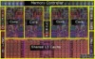

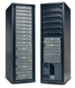
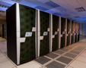
The GraphLab Goals
Designed specifically for ML
Graph dependencies
Iterative
Asynchronous
Dynamic
Simplifies design of parallel programs:
Abstract away hardware issues
Automatic data synchronization
Addresses multiple hardware architectures
Know how to solve ML problem on 1 machine
Efficient
parallel predictions

Slide 44
Data Graph
Data associated with vertices and edges
Graph:
Social Network
Vertex Data:
User profile text
Current interests estimates
Edge Data:
Similarity weights

Slide 45
Update Functions
User-defined program: applied to vertex transforms data in scope of vertex
pagerank(i, scope){
// Get Neighborhood data
(R[i], w_{ij}, R[j]) ←scope;
// Update the vertex data
// Reschedule Neighbors if needed
if R[i] changes then
reschedule_neighbors_of(i);
}
Update function applied (asynchronously)
in parallel until convergence
Many schedulers available to prioritize computation
Dynamic computation

Slide 46
The Scheduler
The scheduler determines the order that vertices are updated
CPU 1
b
c
d
a
b
c
Scheduler
e
f
b
e
f
g
a
i
h
i
j
h
i
j
k
CPU 2
The process repeats until the scheduler is empty

Slide 47
Ensuring Race-Free Code
How much can computation overlap?

Slide 48
Need for Consistency?
No Consistency
Higher Throughput
(#updates/sec)
Potentially Slower Convergence of ML

Slide 49
Consistency in Collaborative Filtering
Inconsistent updates
Consistent updates
GraphLab guarantees consistent updates
User-tunable consistency levels
trades off parallelism & consistency
Netflix data, 8 cores
Notes:
Full netflix, 8 cores
Highly connected movies, bad intermediate results

Slide 50
The GraphLab Framework
Graph Based
Data Representation
Update Functions
User Computation
Scheduler
Consistency Model

Slide 51
Alternating Least
Squares
SVD
Splash Sampler
CoEM
Bayesian Tensor
Factorization
Lasso
Belief Propagation
PageRank
LDA
SVM
Gibbs Sampling
Dynamic Block Gibbs Sampling
K-Means
Matrix
Factorization
…Many others…
Linear Solvers

Slide 52
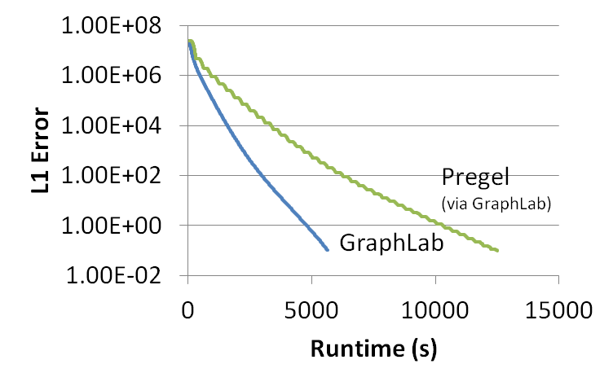
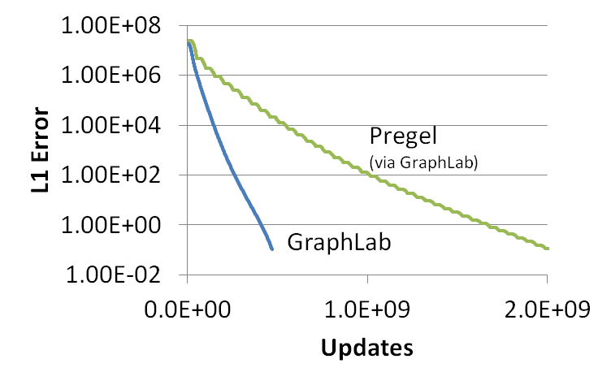
GraphLab vs. Pregel (BSP)
51% updated only once
PageRank (25M Vertices, 355M Edges)

Slide 53
Never Ending Learner Project (CoEM)
Better
Optimal
Hadoop | 95 Cores | 7.5 hrs
GraphLab | 16 Cores | 30 min
GraphLab CoEM
Distributed GraphLab | 32 EC2 machines | 80 secs
6x fewer CPUs!
15x Faster!
0.3% of Hadoop time
53

Slide 54
The Cost of the Wrong Abstraction
Log-Scale!

Slide 55
GraphLab1 provided exciting scaling performance
Thus far…
But…
We couldn’t scale up to
Altavista Webgraph 2002
1.4B vertices, 6.7B edges

Slide 56
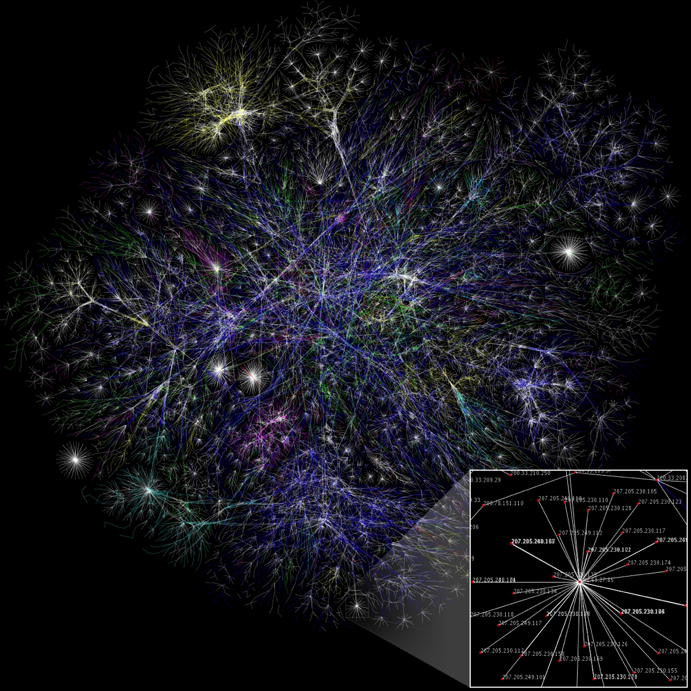
Natural Graphs
[Image from WikiCommons]

Slide 57
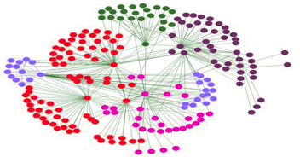
Assumptions of Graph-Parallel Abstractions
Idealized Structure
Natural Graph
Small neighborhoods
Low degree vertices
Similar degree
Easy to partition
Large Neighborhoods
High degree vertices
Power-Law degree distribution
Difficult to partition

Slide 58
Natural Graphs → Power Law
Top 1% of vertices is adjacent to
53% of the edges!
“Power Law”
-Slope = α ≈ 2
Altavista Web Graph: 1.4B Vertices, 6.7B Edges

Slide 59
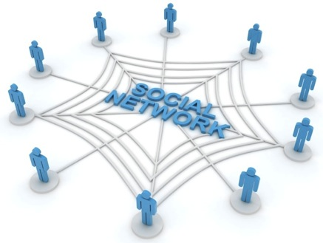


High Degree Vertices are Common
“Social” People
Popular Movies
Users
Netflix
Movies
Hyper Parameters
Common Words
θ
B
α
θ
Docs
LDA
Z
θ
Z
θ
Z
Z
Z
Z
Z
Obama
Z
w
Z
w
Z
Z
w
Z
w
Z
w
Z
w
w
Z
w
Z
w
w
w
Words
w
w
w
w
w

Slide 60
Problem: High Degree Vertices Limit Parallelism
Edge information too large for single machine
Touches a large
fraction of graph
(GraphLab 1)
Produces many
messages
(Pregel)
Sequential
Vertex-Updates
Asynchronous consistency requires heavy locking (GraphLab 1)
Synchronous consistency is prone to stragglers (Pregel)

Slide 61
Problem: High Degree Vertices ➔ High Communication for Distributed Updates
Data transmitted
across network
O(# cut edges)
Y
Natural graphs do not have low-cost balanced cuts
[Leskovec et al. 08, Lang 04]
Popular partitioning tools (Metis, Chaco,…) perform poorly
[Abou-Rjeili et al. 06]
Extremely slow and require substantial memory
Machine 1
Machine 2

Slide 62
Random Partitioning
Both GraphLab1 and Pregel proposed Random (hashed) partitioning for Natural Graphs
For p Machines:
10 Machines → 90% of edges cut
100 Machines → 99% of edges cut!
Machine 1
Machine 2

Slide 63
In Summary
GraphLab1 and Pregel are not well suited for natural graphs
Poor performance on high-degree vertices
Low Quality Partitioning

Slide 64
2
Distribute a single vertex-update
Move computation to data
Parallelize high-degree vertices
Vertex Partitioning
Simple online approach, effectively partitions large power-law graphs

Slide 65
Factorized Vertex Updates
Split update into 3 phases
Gather
Apply
Scatter
Scope
Y
Y
Y
Parallel
Sum
+ + … + → Δ
Locally apply the
accumulated Δ to vertex
Update neighbors
Y
Y
Y
Data-parallel over edges
Apply( , Δ) →
Y
Data-parallel over edges
Y

Slide 66
PageRank in GraphLab2
PageRankProgram(i)
Gather( j → i ) : return w_{ji} * R[j]
sum(a, b) : return a + b;
Apply(i, Σ) : R[i] = β + (1 – β) * Σ
Scatter( i → j ) : if (R[i] changes) then activate(j)
Notes:
How ever, in some cases, this can seem rather inefficient.

Slide 67
Distributed Execution of a GraphLab2 Vertex-Program
Machine 1
Machine 2
Gather
Y’
Y’
Y’
Y’
Σ₁
Σ
Σ₂
+ + +
Apply
Y
Y
Y
Y
Machine 3
Machine 4
Scatter
Σ₃
Σ₄

Slide 68
Minimizing Communication in GraphLab2
Communication is linear in the number of machines each vertex spans
Y
Y
Y
A vertex-cut minimizes machines each vertex spans
Percolation theory suggests that power law graphs have good vertex cuts. [Albert et al. 2000]

Slide 69
Minimizing Communication in GraphLab2: Vertex Cuts
Communication linear in # spanned machines
Y
Y
Y
A vertex-cut minimizes # machines per vertex
Percolation theory suggests Power Law graphs can be split by removing only a small set of vertices [Albert et al. 2000]
➔
Small vertex cuts possible!

Slide 70
Constructing Vertex-Cuts
Goal: Parallel graph partitioning on ingress
GraphLab 2 provides three simple approaches:
Random Edge Placement
Edges are placed randomly by each machine
Good theoretical guarantees
Greedy Edge Placement with Coordination
Edges are placed using a shared objective
Better theoretical guarantees
Oblivious-Greedy Edge Placement
Edges are placed using a local objective

Slide 71
Random Vertex-Cuts
Randomly assign edges to machines
Machine 1
Machine 2
Machine 3
Balanced Cut
Y
Spans 3 Machines
Y
Y
Y
Y
Y
Z
Y
Z
Y
Y
Y
Z
Z
Spans 2 Machines
Spans only 1 machine

Slide 72
Random Vertex Cuts vs Edge Cuts

Slide 73
Greedy Vertex-Cuts
Place edges on machines which already have the vertices in that edge.
Machine1
Machine 2
A
B
B
C
A
B
D
E
Notes:
Greedy algorithm is no worse than random placement in expectation

Slide 74
Greedy Vertex-Cuts
Derandomization: Minimizes the expected number of machines spanned by each vertex.
Coordinated
Maintain a shared placement history (DHT)
Slower but higher quality
Oblivious
Operate only on local placement history
Faster but lower quality
Notes:
Greedy algorithm is no worse than random placement in expectation

Slide 75
Partitioning Performance
Twitter Graph: 41M vertices, 1.4B edges
Cost
Construction Time
Random
Oblivious
Better
Oblivious
Coordinated
Coordinated
Random
Oblivious balances partition quality and partitioning time.
Notes:
Put Random, coordinated, then oblivious as compromise

Slide 76
Beyond Random Vertex Cuts!

Slide 77
From the Abstraction to a System
2

Slide 78
Graph Analytics
Graphical Models
Computer Vision
Clustering
Topic Modeling
Collaborative Filtering
GraphLab Version 2.1 API (C++)
Sync. Engine
Async. Engine
Map/Reduce
Ingress
Distributed Graph
Fault Tolerance
MPI/TCP-IP Comms
PThreads
Boost
Hadoop/HDFS
Linux Cluster Services (Amazon AWS)
Notes:
Substantially simpler than original GraphLab
Synchronous engine < 600 lines of code

Slide 79
Triangle Counting in Twitter Graph
Total:
34.8 Billion Triangles
40M Users 1.2B Edges
1536 Machines
423 Minutes
64 Machines, 1024 Cores
1.5 Minutes
Hadoop results from [Suri & Vassilvitskii '11]
Notes:
Hadoop [1] S. Suri and S. Vassilvitskii, “Counting triangles and the curse of the last reducer,” presented at the WWW '11: Proceedings of the 20th international conference on World wide web, 2011.

Slide 80
LDA Performance
All English language Wikipedia
2.6M documents, 8.3M words, 500M tokens
LDA state-of-the-art sampler (100 Machines)
Alex Smola: 150 Million tokens per Second
GraphLab Sampler (64 cc2.8xlarge EC2 Nodes)
100 Million Tokens per Second
Using only 200 Lines of code and 4 human hours

Slide 81
PageRank
5.5 hrs
$180
$41
1 hr
$12
8 min
40M Webpages, 1.4 Billion Links
Hadoop results from [Kang et al. '11]
Twister (in-memory MapReduce) [Ekanayake et al. ‘10]
Notes:
“Comparable numbers are hard to come by as everyone uses different datasets, but we try to equalize as much as possible giving the competition an advantage when in doubt”
Scaling to 100 iterations so costs are in dollars and not cents.
Numbers:
Hadoop: Ran on Kronecker graph of 1.1B edges, 50 M45 machines.
From available numbers, each machine is approximately 8 cores, 6 GB RAM or roughly a c1.xlarge instance. Putting total cost at $33 per hour
Spectral Analysis for Billion-Scale Graphs: Discoveries and Implementation U Kang Brendan Meeder Christos Faloutsos
Twister: Ran on ClueWeb dataset of 50M pages, 1.4B edges.
Using 64 Nodes of 4 cores each. 16GB RAM per node. Or roughly a m2.xlarge to m2.2xlarge instance. Putting total cost at $28-$56 per hour.
Jaliya Ekanayake, Hui Li, Bingjing Zhang, Thilina Gunarathne, Seung-Hee Bae, Judy Qiu, Geoffrey Fox, Twister: A Runtime for Iterative MapReduce," The First International Workshop on MapReduce and its Applications (MAPREDUCE'10) - HPDC2010
GraphLab: Ran on 64 cc1.4x large instances at $83.2 per hour

Slide 82

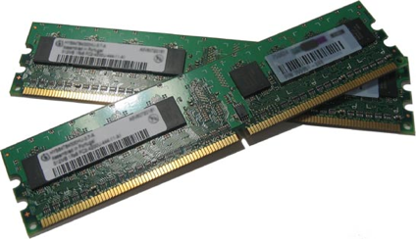

How well does GraphLab scale?
Yahoo Altavista Web Graph (2002):
One of the largest publicly available webgraphs
1.4B Webpages, 6.6 Billion Links
11 Mins
1B links processed per second
30 lines of user code
64 HPC Nodes
1024 Cores (2048 HT)
4.4 TB RAM

Slide 83
Release 2.1 available now Apache 2 License

Slide 84
GraphLab Toolkits
Graph Analytics
Graphical Models
Computer Vision
Clustering
Topic Modeling
Collaborative Filtering
GraphLab Version 2.1 API (C++)
MPI/TCP-IP
PThreads
Hadoop/HDFS
Linux Cluster Services (Amazon AWS)
GraphLab easily incorporates external toolkits
Automatically detects and builds external toolkits

Slide 85
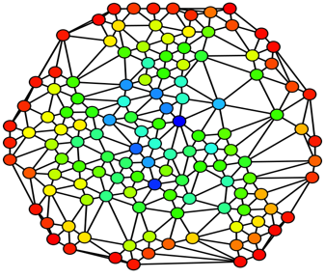
Graph Processing
Algorithms
Triangle Counting
Pagerank
K-Cores
Shortest Path
Coming soon:
Max-Flow
Matching
Connected Components
Label propagation
Extract knowledge from graph structure
Find communities
Identify important individuals
Detect vulnerabilities
Notes:
http://en.wikipedia.org/wiki/Social_network_analysis

Slide 86
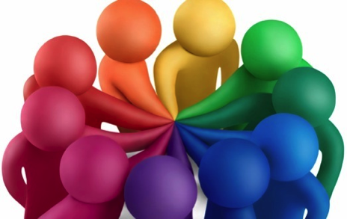
Collaborative Filtering
Understanding Peoples
Shared Interests
Target advertising
Improve shopping experience
Algorithms
ALS, Weighted ALS
SGD, Biased SGD
Proposed:
SVD++
Sparse ALS
Tensor Factorization
Notes:
http://glamproduction.wordpress.com/360-cross-platform-pitch-draft/
http://ozgekaraoglu.edublogs.org/2009/07/31/two-gr8-projects-to-collaborate/

Slide 87
Graphical Models
Probabilistic analysis for correlated data.
Improved predictions
Quantify uncertainty
Extract relationships
Algorithms
Loopy Belief Propagation
Max Product LP
Coming soon:
Gibbs Sampling
Parameter Learning
L₁ Structure Learning
M³ Net
Kernel Belief Propagation
User 1
User 2
User 3
Ad 1
Ad 2

Slide 88


Structured Prediction
Input:
Prior probability for each vertex
Edge List
Smoothing Parameter (e.g., 2.0)
Output: posterior
User Id | Pr(Conservative) | Pr(Not Conservative)
1 | 0.8 | 0.2
2 | 0.5 | 0.5
3 | 0.3 | 0.7
… | … | …
User Id | Pr(Conservative) | Pr(Not Conservative)
1 | 0.7 | 0.3
2 | 0.3 | 0.7
3 | 0.1 | 0.8
… | … | …

Slide 89

Computer Vision (CloudCV)
Making sense of pictures.
Recognizing people
Medical imaging
Enhancing images
Algorithms
Image stitching
Feature extraction
Coming soon:
Person/object detectors
Interactive segmentation
Face recognition
Notes:
Image: http://www.cs.brown.edu/courses/cs143/

Slide 90
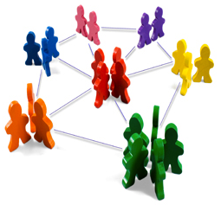
Clustering
Identify groups of related data
Group customer and products
Community detection
Identify outliers
Algorithms
K-Means++
Coming soon:
Structured EM
Hierarchical Clustering
Nonparametric *-Means
Notes:
Image: http://jordi.pro/netbiz/2012/05/connecting-people-a-must-for-clusters/

Slide 91

Topic Modeling
Extract meaning from raw text
Improved search
Summarize textual data
Find related documents
Algorithms
LDA Gibbs Sampler
Coming soon:
CVB0 for LDA
LSA/LSI
Correlated topic models
Trending Topic Models
Notes:
Image: http://knowledgeblog.org/files/2011/03/jiscmrd_wordle.png

Slide 92

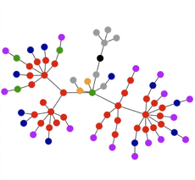

GraphChi: Going small with GraphLab
Solve huge problems on small or embedded devices?
Key: Exploit non-volatile memory (starting with SSDs and HDs)

Slide 93
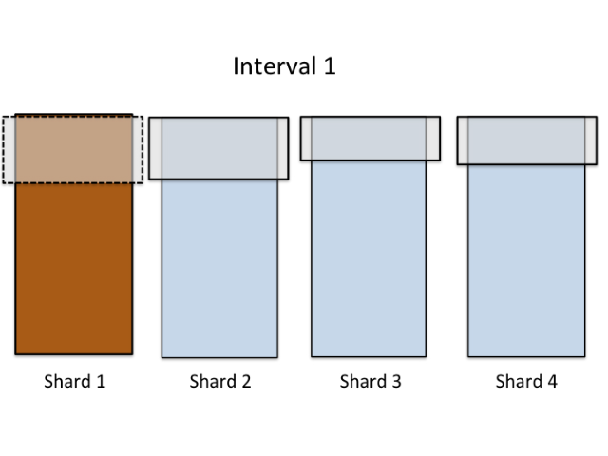
GraphChi – disk-based GraphLab
Novel Parallel Sliding
Windows algorithm
Fast!
Solves tasks as large as current distributed systems
Minimizes disk seeks
Efficient on both SSD and hard-drive
Multicore Asynchronous execution

Slide 94
Triangle Counting in Twitter Graph
40M Users 1.2B Edges
Total: 34.8 Billion Triangles
1536 Machines
423 Minutes
59 Minutes
59 Minutes, 1 Mac Mini!
64 Machines, 1024 Cores
1.5 Minutes
Hadoop results from [Suri & Vassilvitskii '11]
Notes:
Hadoop [1] S. Suri and S. Vassilvitskii, “Counting triangles and the curse of the last reducer,” presented at the WWW '11: Proceedings of the 20th international conference on World wide web, 2011.

Slide 95




Release 2.1 available now
http://graphlab.org
Documentation… Code… Tutorials… (more on the way)
GraphChi 0.1 available now
http://graphchi.org

Slide 96
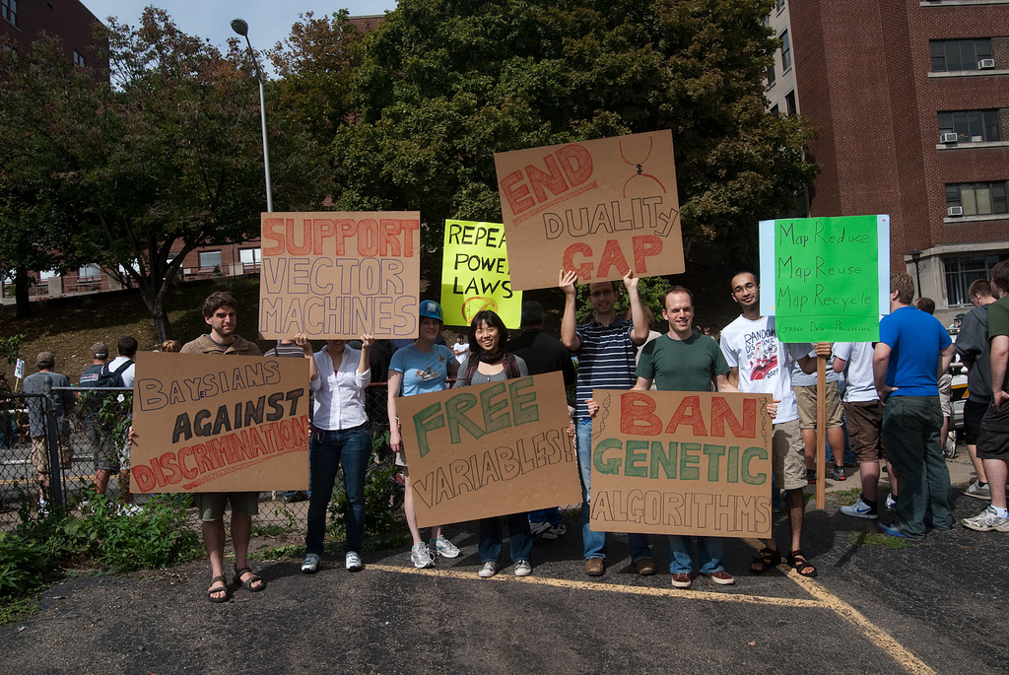

Slide 97
Open Challenges

Slide 98
Dynamically Changing Graphs
Example: Social Networks
New users → New Vertices
New Friends → New Edges
How do you adaptively maintain computation:
Trigger computation with changes in the graph
Update “interest estimates” only where needed
Exploit asynchrony
Preserve consistency

Slide 99
Graph Partitioning
How can you quickly place a large data-graph in a distributed environment:
Edge separators fail on large power-law graphs
Social networks, Recommender Systems, NLP
Constructing vertex separators at scale:
No large-scale tools!
How can you adapt the placement in changing graphs?

Slide 100
Graph Simplification for Computation
Can you construct a “sub-graph” that can be used as a proxy for graph computation?
See Paper:
Filtering: a method for solving graph problems in MapReduce.
http://research.google.com/pubs/pub37240.html

Slide 101
Concluding BIG Ideas
Modeling Trend: Independent Data → Dependent Data
Extract more signal from noisy structured data
Graphs model data dependencies
Captures locality and communication patterns
Data-Parallel tools not well suited to Graph Parallel problems
Compared several Graph Parallel Tools:
Pregel / BSP Models:
Easy to Build, Deterministic
Suffers from several key inefficiencies
GraphLab:
Fast, efficient, and expressive
Introduces non-determinism
GraphLab2:
Addresses the challenges of computation on Power-Law graphs
Open Challenges: Enormous Industrial Interest

Slide 102
Fault Tolerance

Slide 103
Checkpoint Construction
Pregel (BSP)
GraphLab
Compute
Communicate
Barrier
Checkpoint
Synchronous Checkpoint
Construction
Asynchronous Checkpoint
Construction

Slide 104
Checkpoint Interval
Checkpoint Interval:
T_{i}
Re-compute
Time
Checkpoint
Checkpoint Length:
T_{s}
Machine Failure
Tradeoff:
Short T_{i}: Checkpoints become too costly
Long T_{i} : Failures become too costly
Time
Checkpoint
Checkpoint
Checkpoint
Checkpoint
Checkpoint
Time
Checkpoint

Slide 105
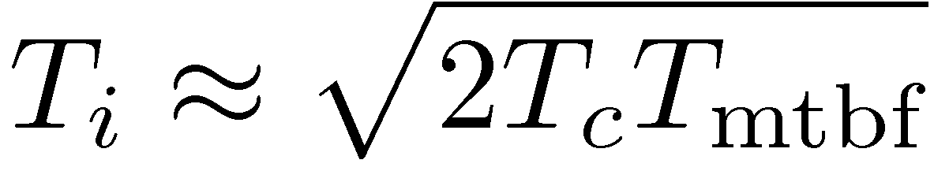
Optimal Checkpoint Intervals
Construct a first order approximation:
Example:
64 machines with a per machine MTBF of 1 year
T_{mtbf} = 1 year / 64 ≈ 130 Hours
T_{c} = of 4 minutes
T_{i} ≈ of 4 hours
Checkpoint Interval
Length of
Checkpoint
Mean time
between failures
From: http://dl.acm.org/citation.cfm?id=361115
Notes:
Correction: Added missing multiple of 2.

